Slide 1
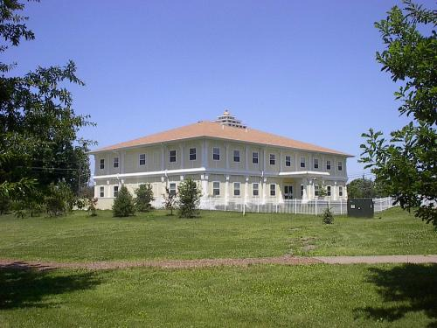
CS401 Modern Programming Practices (MPP) Bright Gee Varghese
MAHARISHI INTERNATIONAL UNIVERSITY
Engaging the Managing Intelligence of Nature
Computer Science Department

Slide 2
Lecture 1: The OO Paradigm for Building Software Solutions
Unlocking the Blueprint of Creation

Slide 3
Wholeness Statement
In the OO paradigm of programming, execution of a program involves objects interacting with objects. Analysis is the process of understanding user requirements and discovering which objects are involved in the problem domain and their relationships, attributes, and behavior. Design turns these discovered objects into a web of software objects from which a fully functioning system is built. Each object has a type, which is embodied in a Java class. The intelligence underlying the functioning of any software object resides in its underlying class, which is the silent basis for the dynamic behavior of objects. Likewise, pure consciousness is the silent level of intelligence that underlies all expressions of intelligence in the form of thoughts and actions in life.

Slide 4
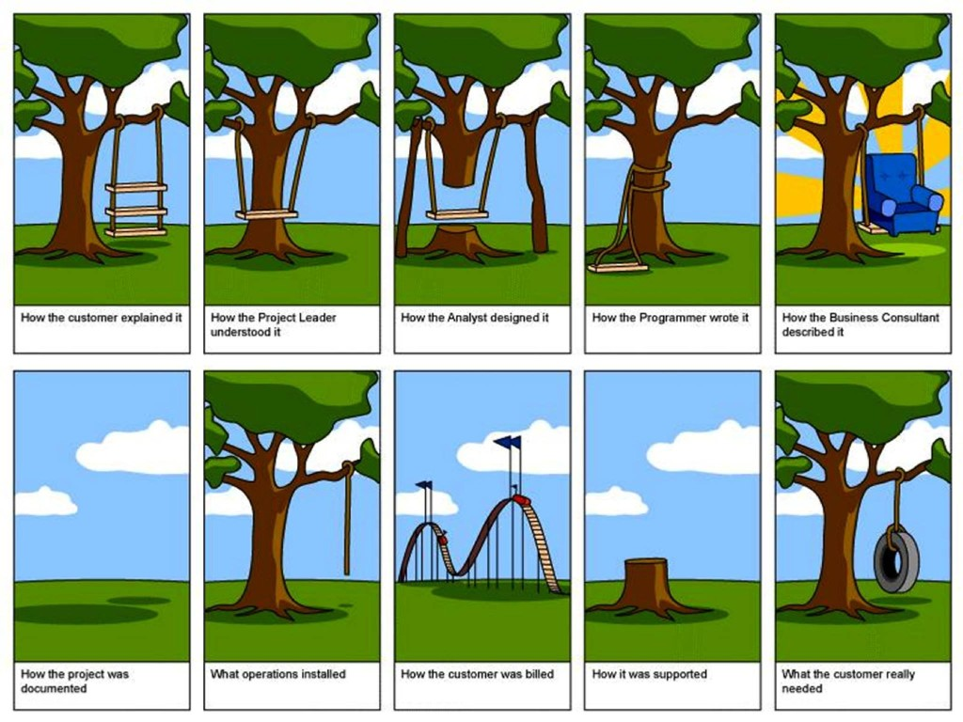

Slide 5
Origin of OO
Problem
Procedural analysis & design
In early days, programmers
adapted real-world
problems into "computer
logic"
OO analysis & design
Using OO, real-world
objects are represented
by software objects;
real-world behavior by
sending messages
between objects
Function 1
Function 2
Function 1.1
Function 1.2
Function 2.1
Function 2.2
Brakes
Stops
Radiator
Tires
Cools
Gear
Reduce RPM
Engine
Moves
Notes:
Objects are abstractions of real world components
Model the static and dynamic properties of the environment
The environment is the problem domain

Slide 6
Object Oriented Principles
Objects have state, behavior, and identity
Encapsulation and Data Hiding
Inheritance (Generalization)
Polymorphism and Late Binding
Delegation

Slide 7
The Goal
We want to build a software system based on objects interacting with objects, following best practices of the OO paradigm Demo: lesson1.lecture.objectdemo
Example: Recall the car example
When we achieve this, there are obvious benefits:
Easy to maintain
Easy to extend and reuse
Easy to understand
To achieve the goal, there are two important steps before writing code:
Analysis: Understand what is needed and model these requirements
Design: Determine how to put the elements discovered in analysis into a system of software objects that function together in a way that meets the user requirements

Slide 8
Steps to Achieve the Goal: The Software Development Lifecycle (SDLC)
To build a software system, these are the key steps in the process:
User Requirements (Analysis): Determine as precisely as possible what problem you are trying to solve and what requirements must be met in your software solution. The first step is some kind of Problem Statement; the next step is done by working out Use Cases
Create a Static Model (Analysis): Based on use cases and the problem statement, determine what the objects of the system are going to be. In this step you identify the classes and create a class diagram. Initially, you will identify classes and attributes (properties) for each class.
Add Relationships to the Static Model (Analysis). Determine from the use cases how classes in your model should be related. Associations and dependencies between classes help to identify how each class should behave and what services each should provide.

Slide 9
(continued)
Create a Dynamic Model (Analysis): For each important flow of a use case, see how a request from a user of the system should be handled by the classes you have identified. You accomplish this when you create sequence diagrams. Build sequence diagrams by studying use cases and by reviewing the associations and dependencies that have been included in your class diagrams. Sequence diagrams help to identify what responsibilities each of your classes will have and therefore what services each of your classes should provide.
Enhance the Static and Dynamic Models (Design): Design is concerned with how to build the system. Previous steps were concerned with modeling the use cases but design is concerned with how to put all the ideas together to build a system. One aspect of design is the intelligent use of abstract classes and interfaces.
Transform UML into Code UML is like an architect's blueprint – it provides clear guidelines for the design, but turning the blueprint into a final product requires additional skills. Code is developed in conjunction with unit tests that verify correctness.

Slide 10
UML
UML (Unified Modeling Language) allows us to build a map of “objects-interacting-with-objects”. It provides a language of diagrams for both analysis and design and supports each step of the SDLC. UML diagrams support:
Understanding user requirements (analysis) – in the form of a use case diagram
Representing the classes or key abstractions within the problem statement and use cases, in the form of a class diagram
Modeling the flow of the application, as determined by use cases, in the form of sequence diagrams.
Notes:
Why UML
1- Graphical representation of software, software is a conceptual idea that needs to be represented in some way.
2- Enable modeling manipulation.
3- Exchange of information between software development parties.
a- Balancing information density and readability.
4- Part of the rules that define the process that in turn ensures harmony within a group to achieve the goals in the best manor passible.

Slide 11
Some Types of UML Diagrams
Use Case Diagram – shows in a single diagram all the use cases for the system
Class Diagram – shows attributes and operations in each of the (primary) classes of the system as well as relationships between them. Used in the Static Model during analysis, and later in design
Sequence Diagram – shows the flow of communication between the running objects of the system, driven by the use cases of the system (e.g.: In an ATM system, a use case “withdraw money”; a sequence diagram will show how the system processes the request to withdraw money). Used for the Dynamic Model.
Object Diagram – shows how, at a particular moment in time, all the instances of the classes communicate with each other. This is part of the Dynamic Model (not discussed in this course)
Many Others! [See the sample diagrams in the materials accompanying this lecture]

Slide 12
Objectives for Next Few Lessons
Modeling a Problem with UML – use the Student Registration System from the book as an example
Use Case Diagram – to specify the use cases
Class Diagram – to specify the objects embedded in the problem statement and use cases
Sequence Diagrams – to model the flow of the application and identify behaviors and responsibilities of classes
Coding
Convert UML Diagrams to OO code
Learn best practices for code and fundamental programming concepts
Development of Consciousness
Regular practice of TM
Connecting CS to SCI and back to CS

Slide 13
Main Point 1
Software is by nature complex, and the only way to manage this complexity is through abstraction. Abstraction is at work when we discover the objects in the problem domain during analysis, and work with these to build a system during design. Abstraction is also at work in creating maps of our objects in the form of UML diagrams.
In a similar way, to manage the complexities of life itself the technique is to saturate awareness with its more abstract levels so that all the details of any situation are appreciated from the broadest perspective. The abstract levels of awareness are experienced in the process of transcending.

Slide 14
Overview
 The Student Registration System (SRS) Problem Statement.
 SRS use cases and Use Case Diagram
 SRS static model – first steps in building a Class Diagram

Slide 15
Problem Description for the SRS
We have been asked to develop an automated Student Registration System (SRS) for the university. This system will enable students to register online for courses each semester, as well as track their progress toward completion of their degree.
When a student first enrolls at the university, he/she uses the SRS to create a plan of study that lists the courses he/she plans on taking to satisfy a particular degree program, and chooses a faculty advisor. The SRS will verify whether or not the proposed plan of study satisfies the requirements of the degree that the student is seeking.
Once a plan of study has been established, then, during the registration period preceding each semester, students are able to view the schedule of classes online and choose whichever classes they wish to attend, indicating the preferred section (day of the week and time of day) if the class is offered by more than one professor.

Slide 16
The SRS will verify whether or not the student has satisfied the necessary prerequisites for each requested course by referring to the student’s online transcript of courses completed and grades received (the student may review his/her transcript online at any time).
Assuming that (a) the prerequisites for the requested course(s) are satisfied, (b) the course(s) meet(s) one of the student’s plan of study requirements, and (c) there is room available in each of the class(es), the student is enrolled in the class(es).
If (a) and (b) are satisfied, but (c) is not, the student is placed on a first-come, first-served wait list. If a class/section that he/she was previously waitlisted for becomes available (either because some other student has dropped the class or because the seating capacity for the class has been increased), the student is automatically enrolled in the waitlisted class, and an email message to that effect is sent to the student. It is the student’s responsibility to drop the class if it is no longer desired; otherwise, he/she will be billed for the course.
Students may drop a class up to the end of the first week of the semester in which the class is being taught.

Slide 17
Plan for Lesson 1
 The Student Registration System (SRS) Problem Statement.
 SRS use cases and Use Case Diagram
 SRS static model – first steps in building a Class Diagram

Slide 18
Use Case Model for the Student Registration System
What is a Use Case?
A Use Case is a sequence of steps performed by a user, interacting with the system, for the purpose of achieving some goal.

Slide 19
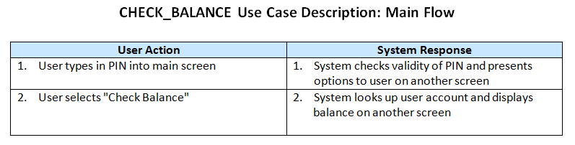
(continued)
A Use Case Description describes the different flows that might occur in a Use Case and clearly indicates the steps in each flow: user actions and system responses. The Main Flow is the expected sequence of steps. There are usually many other flows (Alternate Flows) in which the goal fails to be reached or is achieved in a different way. For this introduction, we will focus on the Main Flow of the Use Cases we look at.
Example Think of an ATM machine as a software system. Use cases for this system include:
Check Balance Withdraw Money Deposit Money

Slide 20
(continued)
Some Use Cases for the Student Registration System: What kinds of things should a user of the system expect to be able to do?
A Student should be able to:
Register for a course
Drop a course
View schedule of classes
A Professor should be able to
Post grades
View a class list
Update course description
[these activities are not specified in the problem statement however]

Slide 21
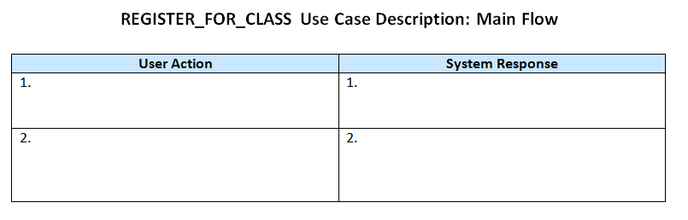
Exercise 1.1: Use Case Description for Register Use Case
Fill in the Use Case description table below. Use the Problem Statement to determine the different user actions and system responses for the main flow of the Register For Class use case.

Slide 22
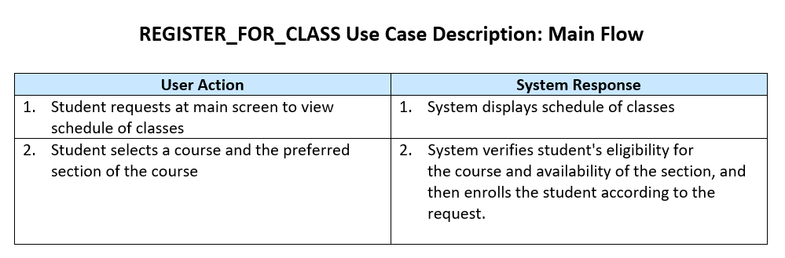
A Solution
Notes
For this MPP course, use this Action / Response pattern when you create a Use Case Description: Each step of the flow of the Use Case begins with a user action and ends with the system response
Avoid branching logic. If a User Action could result in one of two or more System Responses, indicate the System Response that should be considered part of the Main Flow. Other System Responses lead to Alternate Flows. For instance, in this example in this slide, what if the System discovers a student is not eligible for a course? This scenario is possible, but we do not indicate it in the Main Flow – instead, an Alternate Flow should be created that captures this scenario.

Slide 23
Cataloging All Use Cases
A Requirements Specification for a project lists all the use cases along with use case descriptions.
A full account of use cases also requires a list of Actors and a list of the uses cases each Actor interacts with.
An Actor is any entity that either initiates action in the system (like a user) or that is acted upon by the system (like a database). Actors are external to the system.
Here are some Actors in the Student Registration System:
Student, Admissions System, (Professor)

Slide 24
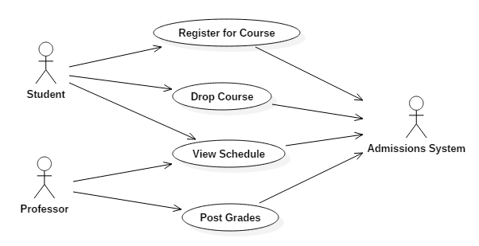
A Partial Use Case Diagram for the Student Registration System

Slide 25
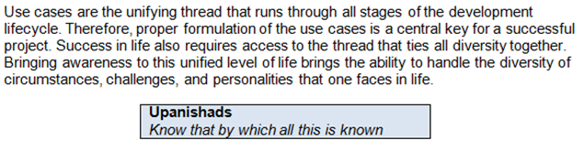
Main Point 2

Slide 26
Plan for Lesson 1
 The Student Registration System (SRS) Problem Statement.
 SRS use cases and Use Case Diagram
 SRS static model – first steps in building a Class Diagram

Slide 27
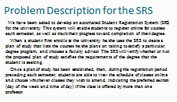
Example: Start Building the Static Model: Find Noun Phrases
Create a list of all the noun phrases from the problem description.
Examples:
student
plan of study
wait list

Slide 28
Problem Description for SRS
We have been asked to develop an automated Student Registration System (SRS) for the university. This system will enable students to register online for courses each semester, as well as track their progress toward completion of their degree.
When a student first enrolls at the university, he/she uses the SRS to set forth a plan of study as to which courses he/she plans on taking to satisfy a particular degree program, and chooses a faculty advisor. The SRS will verify whether or not the proposed plan of study satisfies the requirements of the degree that the student is seeking.
Once a plan of study has been established, then, during the registration period preceding each semester, students are able to view the schedule of classes online, and choose whichever classes they wish to attend, indicating the preferred section (day of the week and time of day) if the class is offered by more than one professor.

Slide 29
The SRS will verify whether or not the student has satisfied the necessary prerequisites for each requested course by referring to the student’s online transcript of courses completed and grades received (the student may review his/her transcript online at any time).
Assuming that (a) the prerequisites for the requested course(s) are satisfied, (b) the course(s) meet(s) one of the student’s plan of study requirements, and (c) there is room available in each of the class(es), the student is enrolled in the class(es).
If (a) and (b) are satisfied, but (c) is not, the student is placed on a first-come, first-served wait list. If a class/section that he/she was previously waitlisted for becomes available (either because some other student has dropped the class or because the seating capacity for the class has been increased), the student is automatically enrolled in the waitlisted class, and an email message to that effect is sent to the student. It is the student’s responsibility to drop the class if it is no longer desired; otherwise, he/she will be billed for the course.
Students may drop a class up to the end of the first week of the semester in which the class is being taught.

Slide 30
List of Noun Phrases (SRS)
system
students
courses
semester
progress
completion
degree
student
university
plan of study
courses
degree program
faculty advisor
plan of study
requirements of degree
student
plan of study
registration period
semester
students
schedule of classes
classes
preferred section
day of the week
time of day
class
professor
student
prerequisites
requested course
student
transcript
courses completed
grades received
student
transcript
student
waitlisted class
email message
student
responsibility
class
course
Students
class
end
NOTES: 1. Many duplicates
2. Prefer singular to plural (“student” instead of “students”)

Slide 31
Sort and Eliminate Duplicates (SRS)
class
class/section that a student was previously wait-listed for
completion
course
courses completed
day of the week
degree
degree program
email message
end
faculty advisor
first-come, firstserved wait list
grades received
plan of study
plan of study requirements
preferred section
prerequisites

Slide 32
(continued)
professor
progress
registration period
requested course
requirements of degree
responsibility
room
schedule of classes
seating capacity
semester
student
system
time of day
transcript
university
waitlisted class

Slide 33
Streamline the List Further
Eliminate terms that do not seem to be objects or that are essentially duplicates, such as: ‘completion’, ‘end’, ‘progress’, ‘responsibility’, and ‘requirements of the degree’. (Note: ‘requirements’ will be wrapped into ‘plan of study requirements’.)
Eliminate reference to the system itself (SRS) and to “university” – our system will (probably) not need to maintain/modify information about the university itself.
It may be hard to decide about some terms (like ‘registration period’ – we expect this term will be used in a different way later). Retain list of eliminated terms, so you can use them later if necessary.

Slide 34
Final List of Noun Phrases (SRS)
class
class/section that he/she was
previously wait-listed for
course
courses completed
day of the week
degree
degree program
email message
faculty advisor
first-come, firstserved wait list
grades received
plan of study
plan of study requirements
preferred section
prerequisites
professor
requested course
room
schedule of classes
seating capacity
section
semester
student
system
time of day
transcript
waitlisted class
Terminology: These noun phrases are called Key Abstractions in software engineering

Slide 35
Main Point 3
The OO approach to building software solutions is to represent objects and behavior in the problem domain with software objects and behavior. One of the first steps in this process is to locate the objects implicit in the problem statement, and this is done by examining nouns and noun phrases in the problem statement. These words and phrases link the real world situation to the abstract realm of software objects. Likewise, linking individual awareness to its abstract foundation in fully expanded awareness is the basis for creating solutions to the real-world challenges of life.

Slide 36
Exercise 1.2
The next step in the Example is to group together terms that are closely related, that belong together, and that can be classified with a single concept.
Example: class, course, waitlisted class belong together
Note: In a real project, sometimes this step requires the assistance of a domain expert because sometimes there is a need to discriminate between subtle shades of meaning

Slide 37
Solution: Group “Synonyms” (SRS)
class
course
waitlisted class
class/section that he/she was
previously wait-listed for
preferred section
requested course
section
prerequisites
day of the week
degree
degree program
email message
faculty advisor
professor
first-come, firstserved wait list
plan of study
plan of study requirements
room
schedule of classes
seating capacity
semester
student
system
time of day
courses completed
grades received
transcript

Slide 38
Example continued: Selecting the Best Among Each Group
Within each grouping, decide which noun phrases most clearly represent a single idea
class
course
waitlisted class
class/section that he/she was
previously wait-listed for
preferred section
requested course
section
prerequisites
NOTE: Words in bold indicate best choices from the groups
Avoid choosing nouns that imply roles in a relationship between objects. For example, “prerequisite” is a role in an association between two courses.
“Waitlisted class”?
“Preferred section”?

Slide 39
(continued)
class
course
waitlisted class
class/section that he/she was
previously wait-listed for
preferred section
requested course
section
prerequisites
day of the week
degree
degree program
email message
faculty advisor
professor
class
course
waitlisted class
class/section that he/she was
previously wait-listed for
preferred section
requested course
section
prerequisites
first-come, first served wait list
plan of study
plan of study requirements
room
schedule of classes
seating capacity
semester
student
system
time of day
courses completed
grades received
transcript
Note: Prefer shorter expressions to longer ones (“degree” instead of “degree program”)
Note: The notion of “transcript” includes “courses completed” and “grades received” although they are not actually synonyms.

Slide 40
Which Nouns Should Become Classes?
Are there any attributes for this class? [Sometimes, can think of attributes for a class but they are not relevant. Example in original noun list: “University”]
Are there any services that would be expected of objects in this class? [Typically, a class will provide services, which in Java are represented by its public methods.]
Can this item simply be included as an attribute of another class? [Example: Should “room” be a class on its own, or an attribute of “section”? Which others can we treat as just attributes?]

Slide 41
Examples of Noun Phrases That Are Attributes Rather Than Classes (SRS)
Day of week
Degree
Seating capacity
Semester
Time of Day

Slide 42
Examples of Noun Phrases That Are Attributes Rather Than Classes (SRS)
Day of week – attribute of Section
Degree – attribute of Student
Seating capacity – attribute of Section
Semester – attribute of Section
Time of Day – attribute of Section

Slide 43
Ignore Implementation Classes During Analysis
Two Main Types of Classes:
Domain Classes: abstractions that the end user will recognize and that represent real-world entities.
Implementation Classes: introduced solely to hold the application together (example: a hashtable to look up students based on ID number, or a special type of list to keep track of professors).
During Analysis, keep only Domain Classes; the others will be useful during design.

Slide 44
SRS Implementation Classes
Email message (sending an email is a behavior we need but the message itself is an implementation class – this is the viewpoint of the book)
Schedule of classes (could be a domain class – for now, think of it as a "computed value" – assembled from other information in the system and displayed to the user in a UI)

Slide 45
Final List of Classes Derived from Noun Phrases
Course (rather than Class)
PlanOfStudy
Professor
Section
Student
Transcript
These represent our first try at identifying objects in the SRS – these will be our key abstractions – classes that are discovered during analysis

Slide 46
Data Dictionary of Classes
Course: a semester-long series of lectures, assignments, exams, etc. that all relate to a particular subject area, and which are typically associated with a particular number of credit hours; a unit of study toward a degree. For example, ‘Software Engineering’ is a required course for the Master of Science Degree in Computer Science.
Plan of Study: a list of the courses that a student intends to take to fulfill the course requirements for a particular degree.

Slide 47
(continued)
Professor: a member of the faculty who teaches sections and/or advises students.
Section: the offering of a particular course during a particular semester on a particular day of the week and at a particular time of day (for example, course ‘Software Engineering' is taught in the Spring 2012 semester on Mondays from 1:00 – 3:00 PM).
Student: a person who is currently enrolled at the university and who is eligible to register for one or more sections.

Slide 48
(continued)
Transcript: a record of all of the courses taken to date by a particular student at this university, including which semester each course was taken in, the grade received, and the credits granted for the course, as well as reflecting an overall total number of credits earned and the student's grade point average (GPA).

Slide 49
The Class Model
Represent key abstractions as "classes", which ultimately display the attributes and services provided by each. Start listing these indicating the most obvious attributes and operations and then plan to gradually add detail as analysis proceeds further.
The Process: From Analysis to Design:
At first we try to understand the user requirements (analysis) and use UML to lay out the classes that are involved. This is the step we have just been working on
Later, as we add more detail and understand the requirements more completely, we enhance our UML class diagrams with design elements and techniques for building the application.

Slide 50
The Class Diagram
Class name goes here
Attributes compartment:
a list of attribute
definitions goes here
Operators compartment:
a list of operation
definitions goes here

Slide 51
Exercise 1.3: Class Diagrams
Create a UML class for Student in the SRS problem.
Look back at the problem description and the definition of a Student.
What attributes naturally belong to Student?
What operations belong with Student? (We will discuss techniques for identifying operations in a later lesson.)

Slide 52
Solution: Student Class Diagram
Student
name
ssn
birthdate
gpa
registerForCourse( )
dropCourse( )
chooseMajor( )

Slide 53
Identifying Attributes
Use requirements to find attributes of domain classes
Use your prior knowledge of the domain to help find attributes (e.g. each student has an ID number)
Talk to the domain expert (often you’re not the expert)
Examine old SRS system already in use to find attributes
Note: Trying to understand domain classes in this way is part of the process of analysis.

Slide 54
Identifying Operations
To identify operations, we need to know how our classes are supposed to behave and what their responsibilities are.
One way to begin is to identify relationships between classes, represented in UML as associations.
Associations can be further analyzed to help specify operations for each class.

Slide 55
Main Point 4
A class encapsulates data, stored as attributes, and behavior, represented as operations. These are the static and dynamic aspects of any class, and a UML diagram for a class provides compartments for each of these. These two aspects of a class – data and behavior – are aspects of anything the we encounter in life. They give expression to the reality that life, at its basis, is a field of existence and intelligence.

Slide 56
Plan for Lesson 1
 The Student Registration System (SRS) Problem Statement.
 SRS use cases and Use Case Diagram
 SRS static model – first steps in building a Class Diagram

Slide 57
Connecting the Parts of Knowledge With the Wholeness of Knowledge
Class diagrams display the data and behaviors of a class
Class diagrams provide an (abstract) representation of a specific real world problem domain.
Transcendental Consciousness is the simplest state of awareness, where the mind goes beyond thoughts and concepts to the most abstract level of awareness – the "abstract content" of awareness
Wholeness moving within itself: In Unity Consciousness, one experiences that all objects in the universe arise from pure consciousness and are ultimately nothing but consciousness.

